Slide 1

Immersion Training
Dennis J. Zhang
Washington University in St. Louis

Slide 2
Session Outline
Mutual Introduction
Course Information

Slide 3
About me
Assistant Professor of OMM in Olin
Academic:
Computer Science and Applied Mathematics Undergraduate at UCLA
Computer Science Master at Georgia Tech
Operations Research and Economics PhD at Northwestern
Professional:
Software Engineer at Symentec
Quotative Trade at Jane Street (Five Rings)
Machine Learning Scientist at Google

Slide 4







About me
Now I actively work with Tech giants, Chinese unicorns, hedge funds and retailers
Tech giants
Chinese unicorns
Retailers

Slide 5
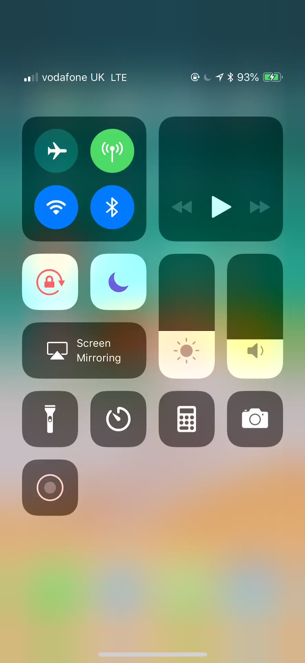
A “live” demo
I designed the current recommendation engine for Alibaba
This is a ”live” demo from yesterday on the recommender system we built with Alibaba.

Slide 6
About this Training
Purpose:
Learn basic Python and Pandas for data science purposes
Learn fundamental supervised learning techniques and deep learning models.
Learn to combine machine learning with optimization to build real-world automated systems.

Slide 7
About this Training

Slide 8
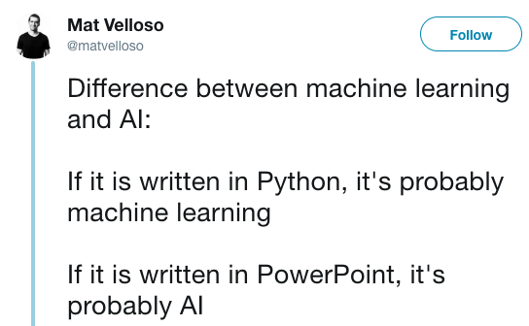
About this Training

Slide 9
About this Training
Part 1: Basic Python with Data Science:
Module 1: Basic Python and corresponding exercises.
Module 2: Data Science with Python Pandas and how to build Recommender Systems.
Project 1: Recommender Systems
Part 2: Supervised Learning Fundamentals, Trees and XGBOOST:
Module 3: Fundamental supervised learning concepts, Decision Tree, Random Forest and XGBOOST
Project 2: Kaggle Machine Learning Competition with XGBOOST

Slide 10
About this Training
Part 3: Machine Learning + Optimization:
Module 4: Machine Learning with Optimization
Project 3: Stochastic Optimization with Machine Learning
Part 4: Neural Networks and Deep Learning:
Module 5: Neural Networks and Deep Learning Models

Slide 11
Structure of Each Part
Each part will consist of 3 things:
For each module in a part:
Class presentation to teach you news skills and techniques.
Practice exercises that help you to directly apply the skills you learnt in this module.
After all modules in one part, we will finish a project that builds upon all knowledge points and techniques from all modules in this paper.
We will have a 10-minute break every 80 minutes.

